Slide 1
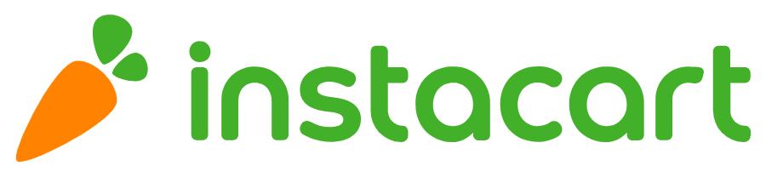
Daten Solutions

Slide 2
Dataset overview
Order_Products
Order_id
Product_id
Add_to_cart_order
Reordered
Orders
User_id
Order_id
Order_dow
Order_hour_of_day
Days_since_prior_order
Products
Product_id
Product_name
Aisle_id
Department_id
Aisles
Aisle_id
Aisle_name
Departments
Department_id
Department_name

Slide 3
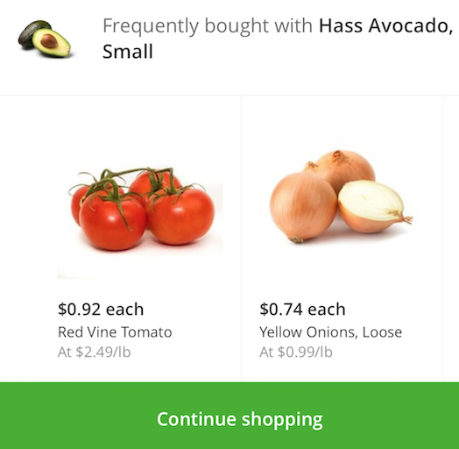
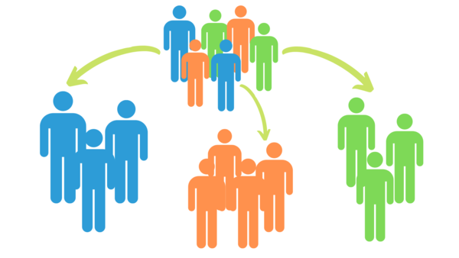
Project Plan
Customer Profiling & Targeting
Recommendation Systems
Notes:
Our approach IS and FOLLOWS the strategy divide (tasks/people), conquer (solve/personalise) and integrate (solution/customers)

Slide 4
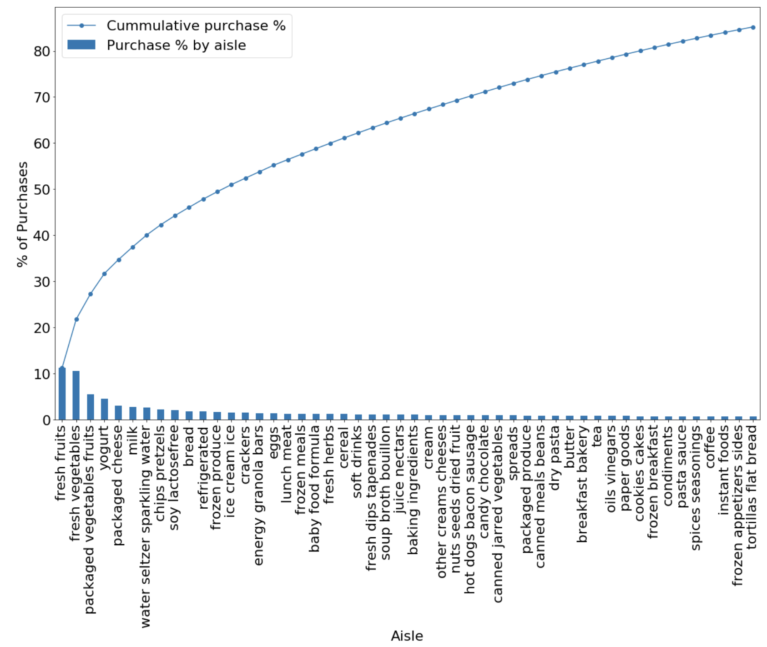
85% of all items purchased come from 35% of the aisles
85%
31% of all products purchased via Instacart are from 4 aisles - fresh fruits, fresh vegetables, packaged vegetables fruits, yogurt
85% of all products purchased via Instacart come from 50 aisles
We will use these top 50 aisles to observe the behavior of our customers in order to segment them
31%
Notes:
Our approach IS and FOLLOWS the strategy divide (tasks/people), conquer (solve/personalise) and integrate (solution/customers)

Slide 5
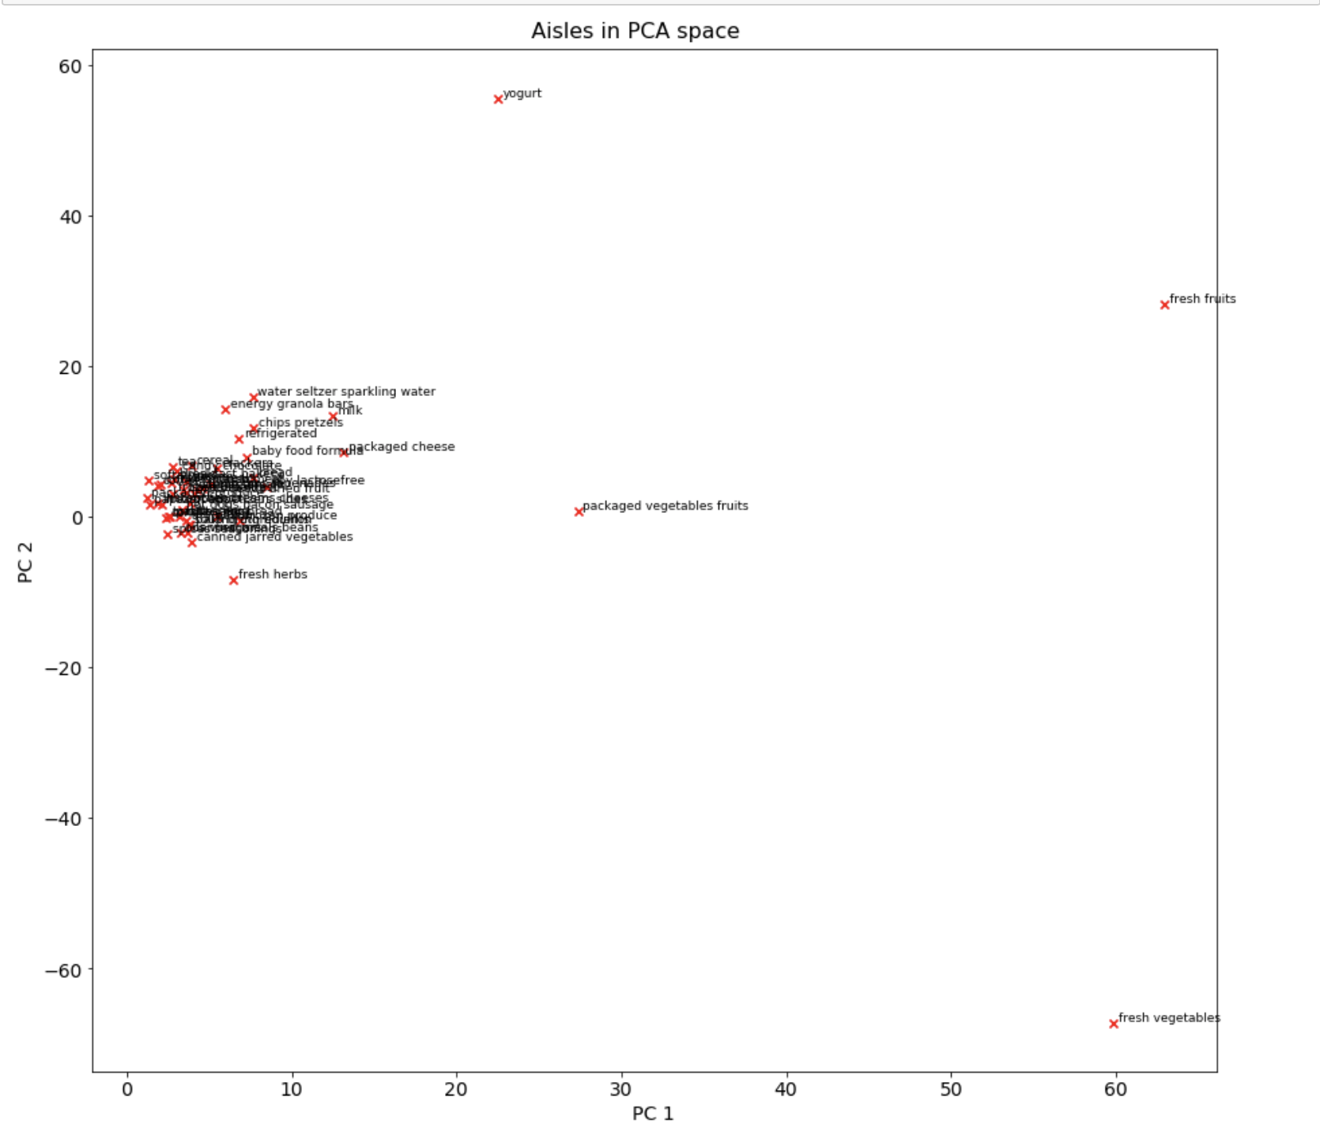
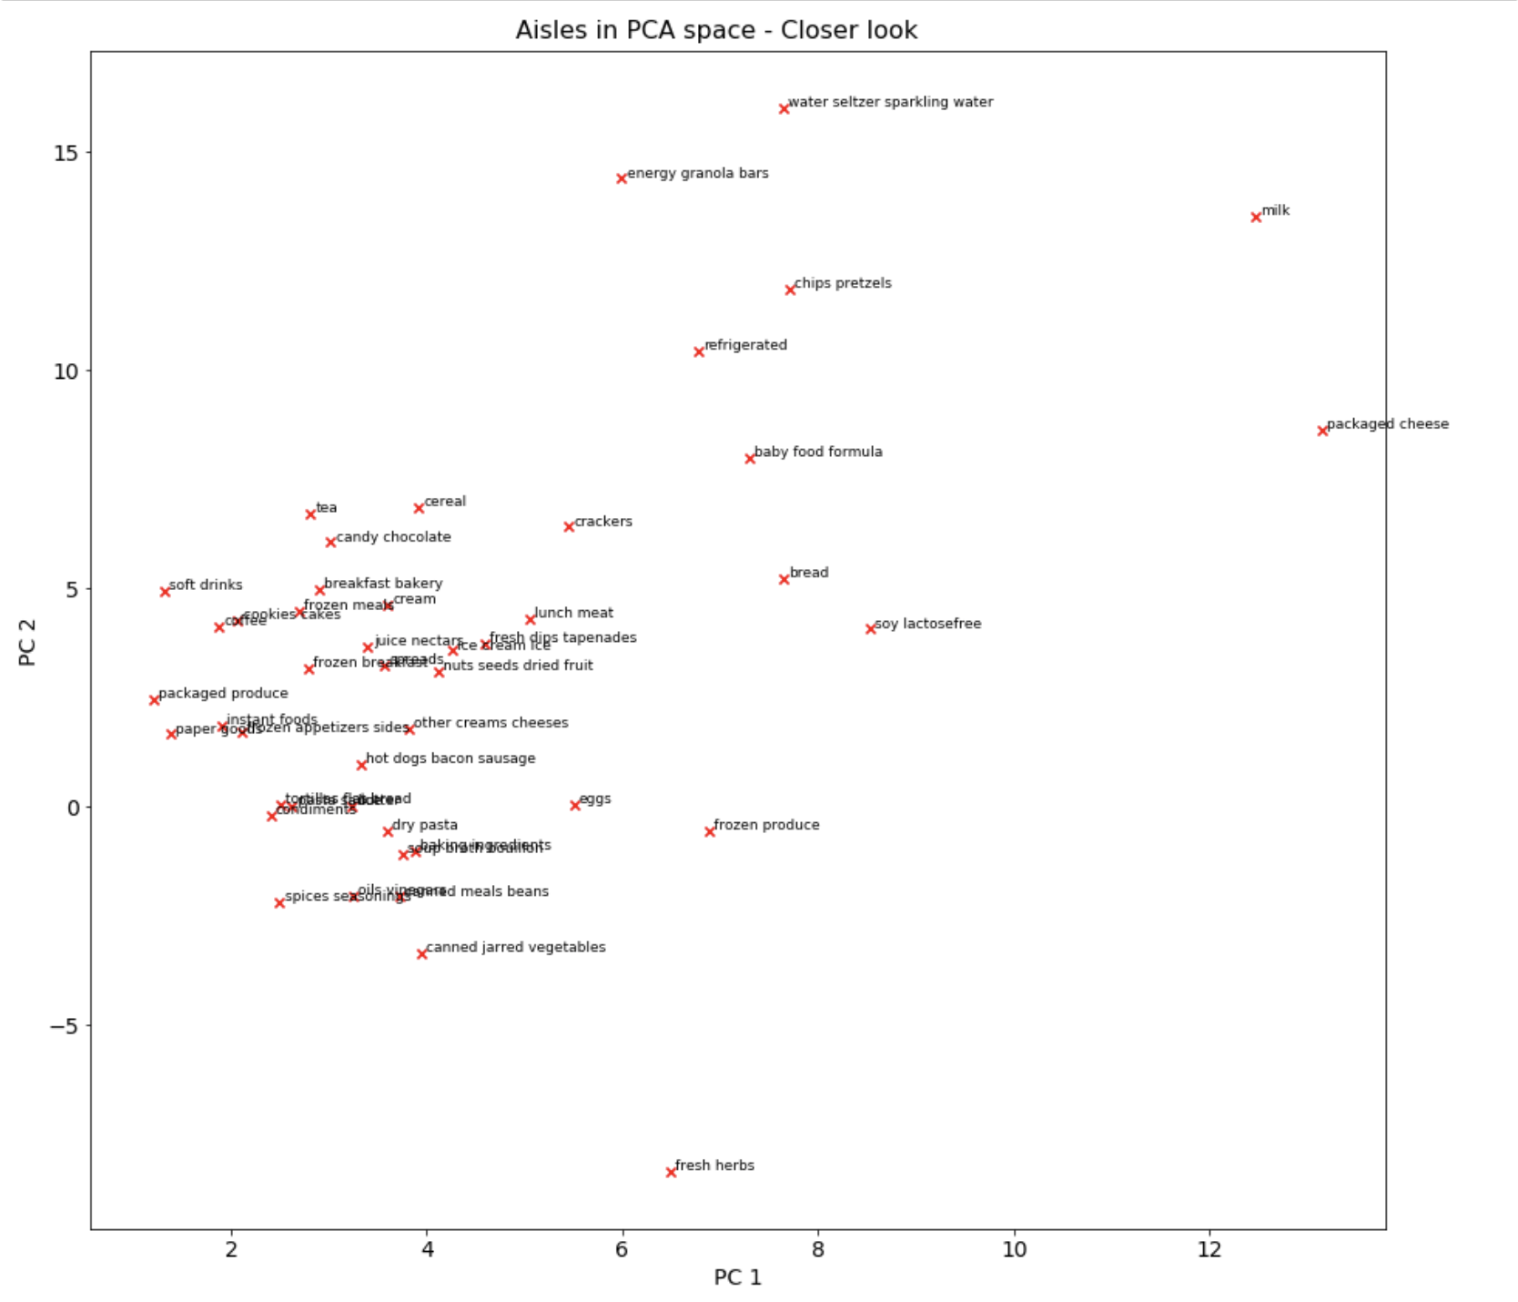
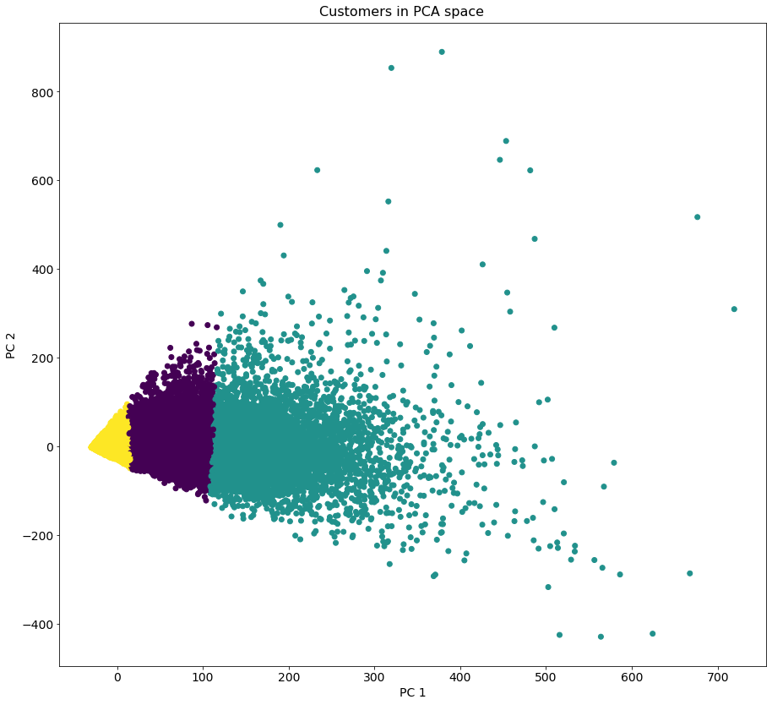
KNN over PCA output provides well separated clusters
We use PCA to reduce the dimensionality from user behavior in 50 aisles down to 2 components that capture ~60% of the variance

Slide 6
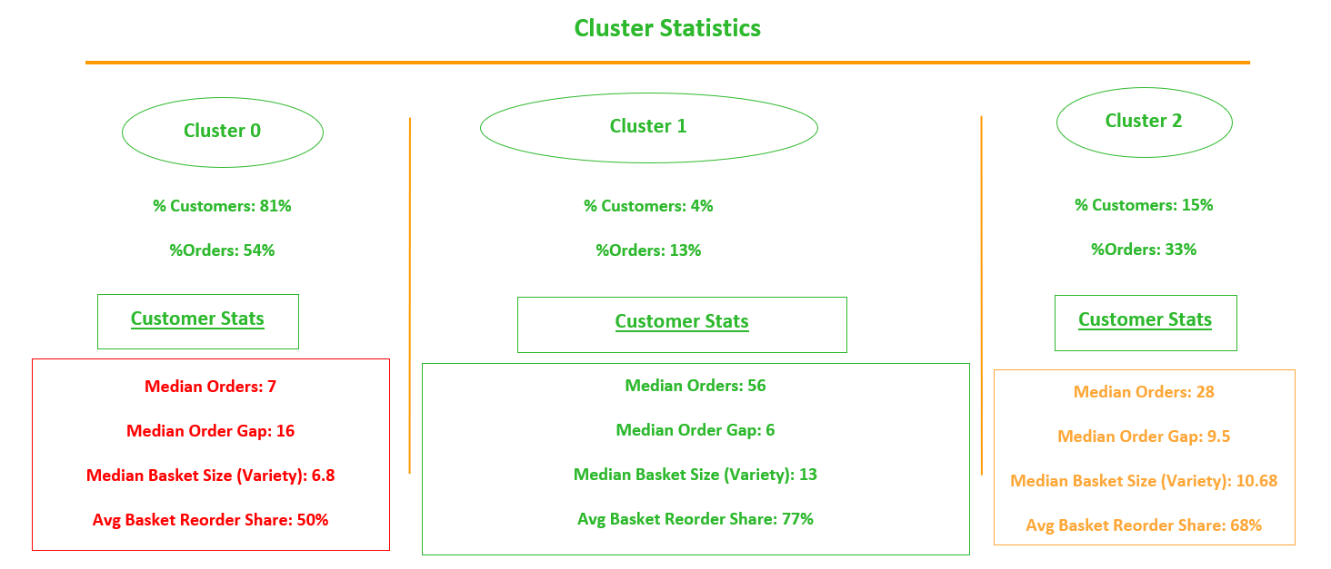
Notes:
% Customers: What % of total customers fall into this cluster
% orders: What % of all orders were placed by customers of this cluster
Median orders: How many orders does the 50th percentile customer place? (How does a typical customer look)
Median order gap: How many orders does the 50th percentile customer place? (How does a typical customer look)
Median Basket Size: How many orders does the 50th percentile customer place? (How does a typical customer look) - since we don’t have quantity of order, the basket size talks about the variety of the basket
Average Basket Reorder Share: On an average, what % of the basket items are reordered ones?

Slide 7
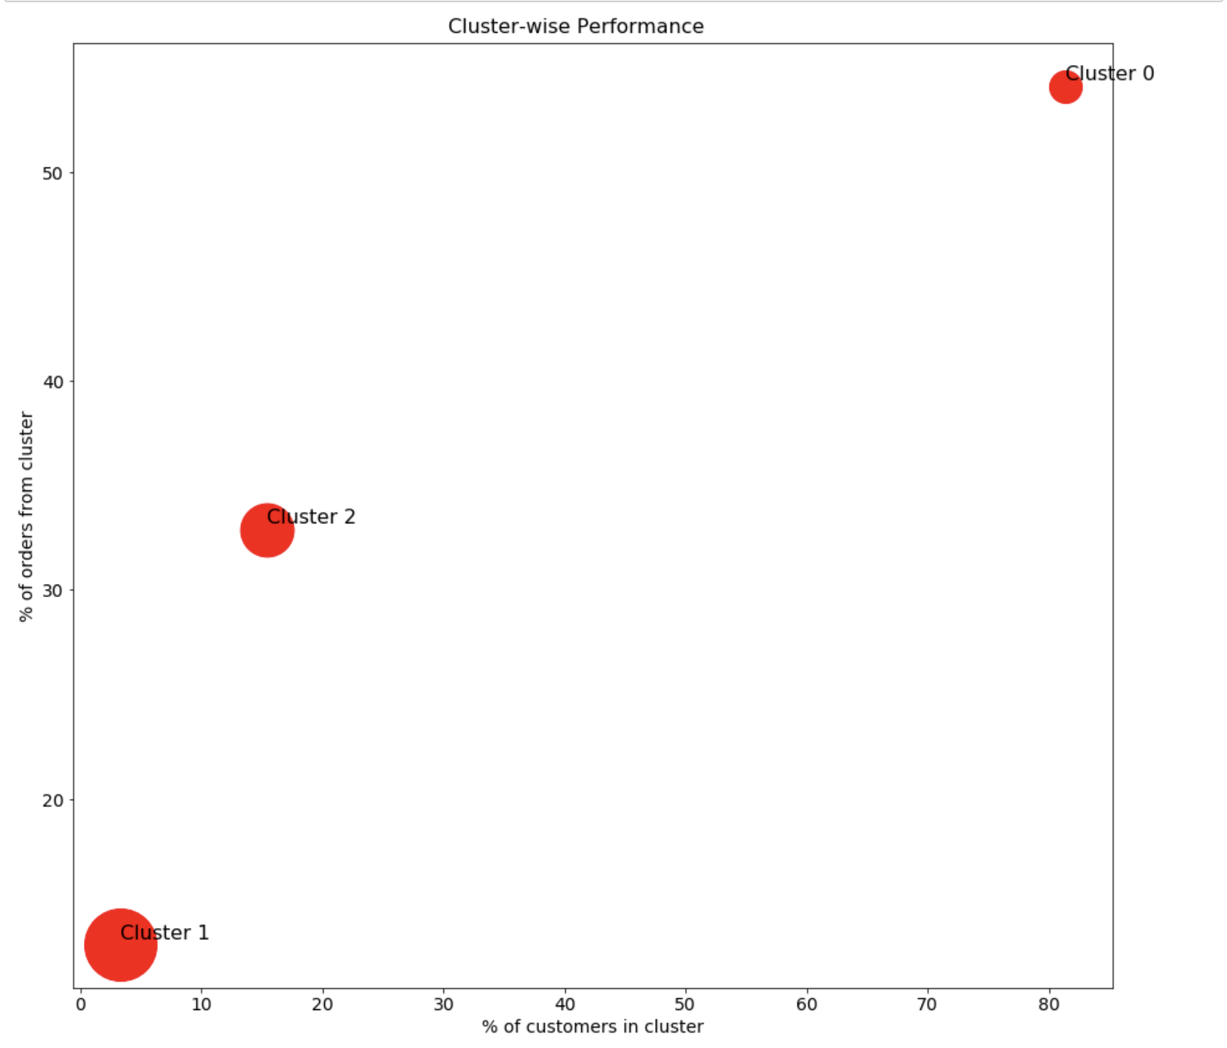
Cluster 0 insights
80% of our customers and 54% of our orders come from cluster 0, which has the lowest basket size among all 3. Since we do not have data for quantity, we conclude that Cluster 0 has the least diverse baskets among all 3 clusters.
Dot size ∝ avg basket size (unique)
Cluster 0 becomes the ideal population for cross-selling focus

Slide 8
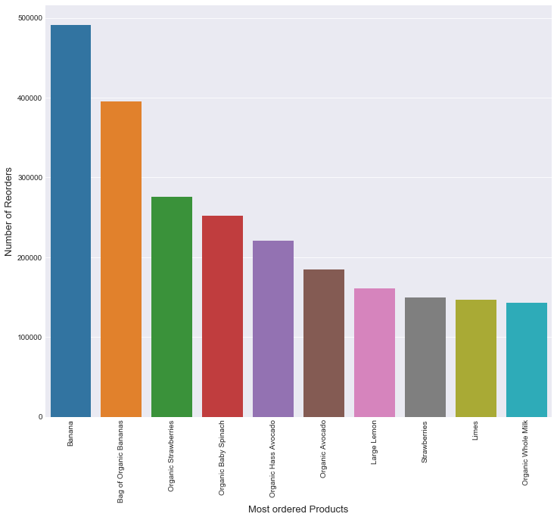
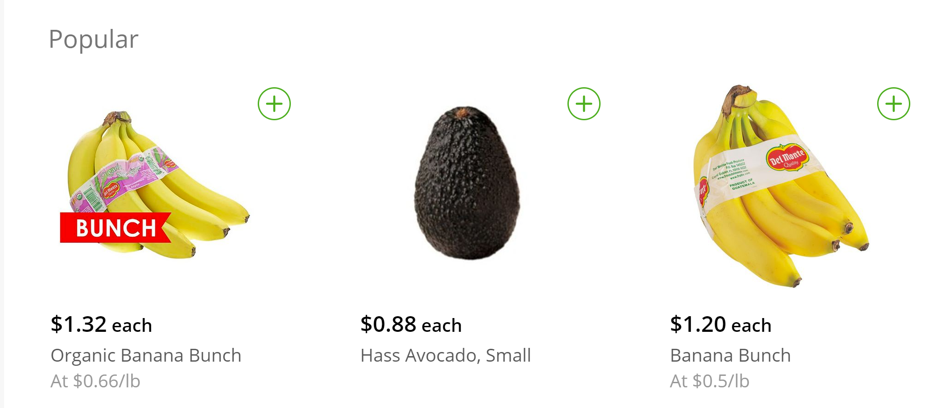
New customers recommendation
2017
2019
Recommend popular products to new customers
Notes:
Since we have no data on new customers, our best guess is to take the behaviour of the overall population as basis for recommendations to them. Based on that, we recommend most popular items to these customers

Slide 9




Most of the customers are buying less
Target Cluster Customers
Best Cluster
Target Cluster
Buy less times
1
Transaction/Customer
0.1x
Median order gap
Buy less often
1
2.7x
Buy less items
1
Basket Variety
0.5x
1
Basket Reorder Share
Buy less repeated items
0.7x
Notes:
80% of our customers drive 50% of our orders and 43% of all purchases (target cluster)
Basket variety for target cluster is half of frequent purchasers on average
Target cluster customers transact at triple the order gap on an average (vs. the most frequently transacting cluster)
Cross-selling will improve assortment and frequency (more products with replenishment requirement) (recommendation results attached in appendix)

Slide 10
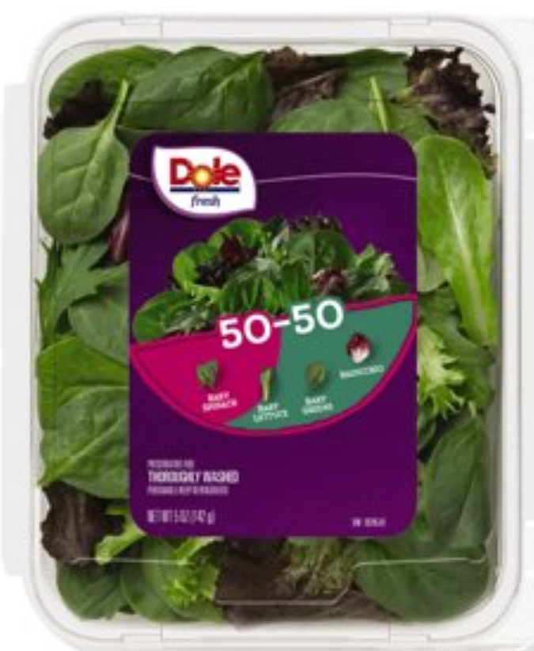
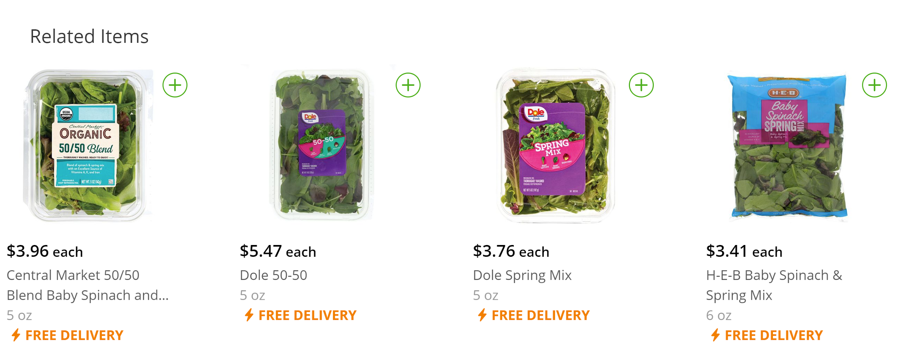
Apriori Algorithm
Identified cluster 0 customers as target, cluster 1 customers as premium customers
Cluster 0 customers have basket variety half of that of cluster 1 customers
Recommend complementary items based on lift scores
Lift score = 5

Slide 11
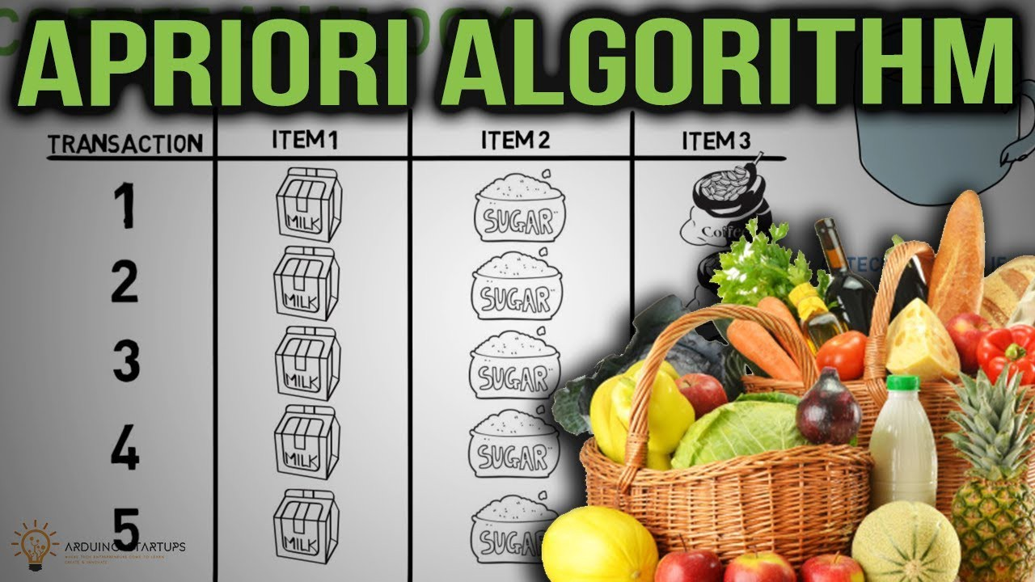
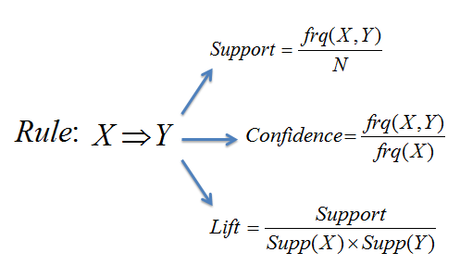
How we built our Recommendation Systems
Association rule based
Repeat based
1.
Identified target and ideal audience
2.
Identified similar items that are reordered more by ideal audience

